Slide 1

Behaviour Driven Development (BDD) With SpecFlow + Selenium
01/02/19 - Dasith Wijesiriwardena

Slide 2

Agenda
Intro to Behaviour Driven Development (BDD)
How BDD can benefit your team
Why you should care about tooling
Using SpecFlow with Selenium
Code Samples

Slide 3
“There is nothing so useless as doing efficiently something that should not have been done at all”
Peter Drucker
Management consultant, educator, and author

Slide 4

Behaviour Driven Development
An Agile methodology that aims to allow software development and management teams to use shared language and processes to communicate and collaborate.
Notes:
Dan North came up with the idea of BDD as a programming methodology that makes it easier for all stakeholders to communicate effectively with each other.
Stemming from DDD practices

Slide 5
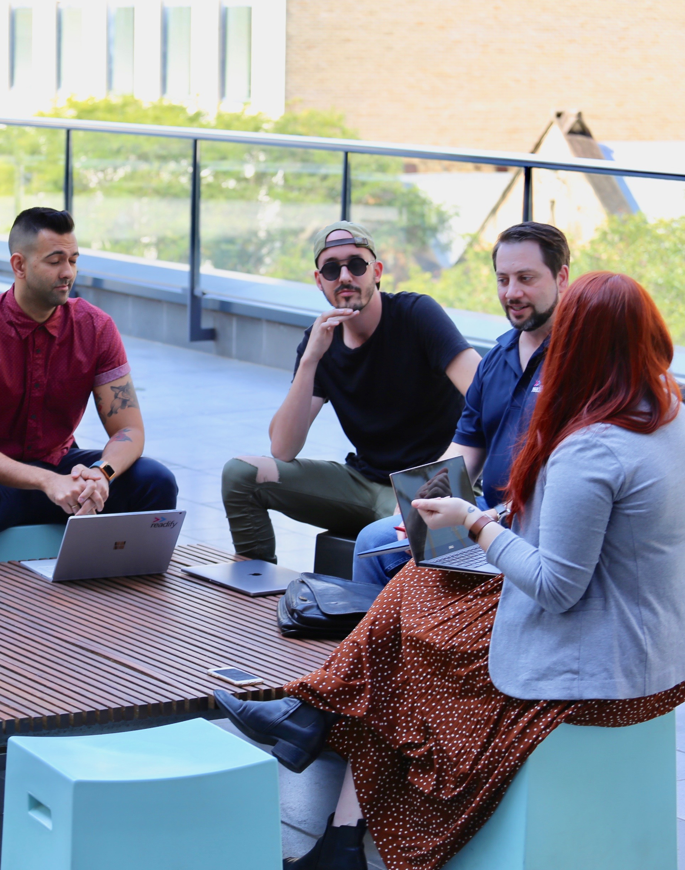
BDD Concepts
Refined Test Driven Development (TDD) .
Focusses on the “behaviour”.
Ubiquitous language.
Minimise waste.
Functional documentation.
Notes:
TDD is functional and lack visibility from outside, prone to misinterpretation
Ubiquitous language minimize misunderstandings and make the development process more visible.
Uses a common technical vocabulary
Spec has executable criteria
“that’ s not what I asked for” or “I forgot to tell you about this other thing”.‘

Slide 6
TDD vs BDD
Test Driven Development | Behaviour Driven Development
Test cases visible to development team | Scenarios are visible to everyone
Tests functional aspects | Tests behavioural aspects
Tests not part of User Acceptance Testing | Tests are part of User Acceptance Testing
Developer/Business can have different interpretations | Shares a common lingo
Tests cases aren’t requirements | Test cases are the requirements

Slide 7

Signs of BDD in practice
Organized conversations between developers, testers and domain experts.
User Story notation stemming from “given-when-then”.
Documentation in sync with the actual behaviour of the system.

Slide 8

Use Caution When Introducing BDD To Your Team
BDD requires understanding of TDD and more.
Changing the status-quo takes time and effort.
Just a conceptual approach. Don’t tie it down to specific tools.
Notes:
Dan North designed it to address recurring issues in the teaching of TDD
Novice programmer should not first learn BDD without prior exposure to TDD concepts

Slide 9

Fail Early = Save Costs
Costs rise exponentially the later bugs are found
within a projects development lifecycle.
1962: NASA’s Mariner 1 bug cost 18 million USD
1990: AT&T long distance calling issue cost 60 million USD
2016: Amazon goes down for 20 minutes, costs 3.75 million USD in sales
Requirements
Design
Development
Testing
Support
https://medium.com/@ryancohane/financial-cost-of-software-bugs-51b4d193f107

Slide 10

Why Use Tooling?
Drive the workflow.
Specification writing.
Test case generation.
Enforce acceptance criteria.
Run test across vertical slices.
Continuous Integration.
Generate documentation.

Slide 11

SpecFlow to the rescue
Define tests in human readable “given-when-then” form.
Generate test stubs from scenarios.
Generate documentation.
Integrates with Visual Studio.
Command line support.
.NET Core support in preview https://github.com/techtalk/SpecFlow/projects/2
Notes:
Dan North designed it to address recurring issues in the teaching of TDD
Novice programmer should not first learn BDD without prior exposure to TDD concepts

Slide 12
“Gherkin” syntax example
Feature: Blog owners can post to their own blog
Background:
Given a customer named “Bill”
And a blog named “Awesome Blog” owned by “Bill”
Scenario: Dr. Bill posts to his own blog
Given I am logged in as “Bill”
When I try to post to “Awesome Blog”
Then I should see “Your article was published.”

Slide 13
Scenario Overview
Customers can put in a booking request.
A booking request can be confirmed using a credit card.
A booking can be cancelled anytime.
If a booking was confirmed and then subsequently cancelled, a cancellation fee is charged.
The cancellation fee depends on the number of people and any special dietary requirements mentioned in the booking.

Slide 14
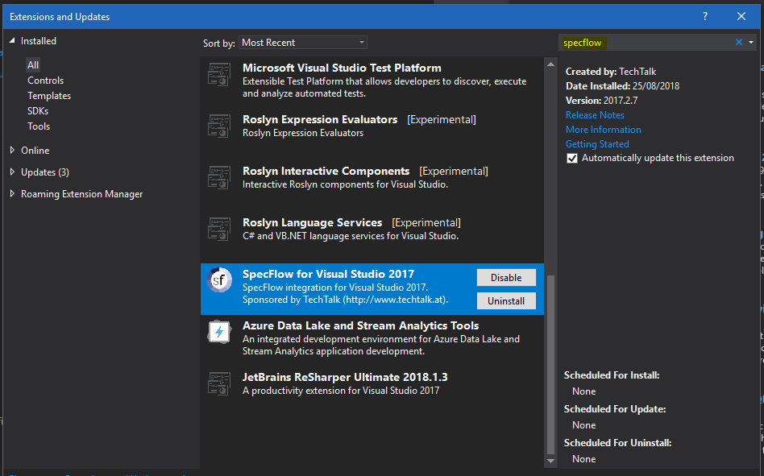
SpecFlow Demo

Slide 15

How does Selenium help?
Run on real browsers and emulate user behaviour.
Test vertical slices and entire stack.
Notes:
Dan North designed it to address recurring issues in the teaching of TDD
Novice programmer should not first learn BDD without prior exposure to TDD concepts

Slide 16

SpecFlow + Selenium = BDD best friends ❤

Slide 17

Thank you
Blog: http://dasith.me
Email: hello@dasith.me

